Slide 1
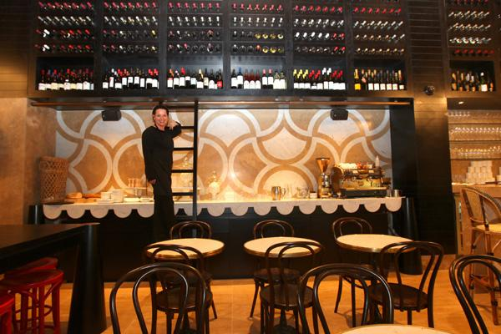
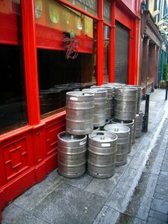
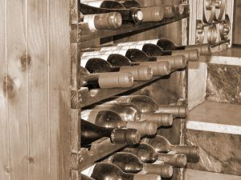
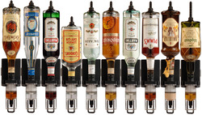
OPERATE A CELLAR SYSTEM
D1.HBS.CL5.05
Notes:
Trainer welcomes students to class.

Slide 2

Subject Elements
This unit comprises four Elements:
Operate and maintain bulk dispensing systems
Operate and maintain beer reticulation systems
Use and maintain refrigeration systems
Monitor quality of cellar products
Notes:
Trainer advises this Unit comprises four Elements, as listed on the slide explaining:
• Each Element comprises a number of Performance Criteria which will be identified throughout the class and explained in detail
• Trainees can obtain more detail from their Trainee Manual
• At times the course presents advice and information about various protocols but where their workplace requirements differ to what is presented, the workplace practices and standards, as well as policies and procedures must be observed.

Slide 3

Assessment
Assessment for this unit may include:
Oral questions
Written questions
Work projects
Workplace observation of practical skills
Practical exercises
Formal report from supervisor
Notes:
Trainer advises that assessment for this Unit may take several forms all of which are aimed at verifying they have achieved competency for the Unit as required.
Trainer indicates the methods of assessment that will be applied to them for this Unit.

Slide 4
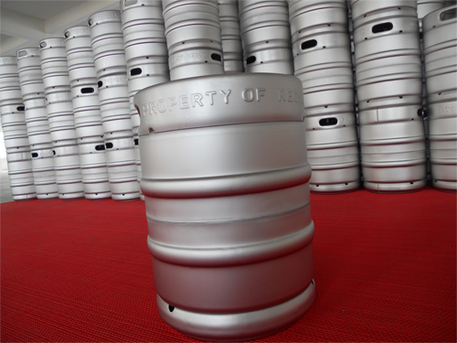
Element 1:
Operate and maintain bulk dispensing systems
Notes:
Introduce topic.
Class Activity – General Discussion
Ask general questions:
What is a cellar?
What equipment is associated with a cellar?
What bulk dispensing systems are used in a bar?

Slide 5
Operate and maintain bulk dispensing systems
Performance Criteria for this Element are:
Operate bulk dispensing systems in accordance with manufacturer's instructions and safety requirements
Monitor temperature, carbonation and pump pressure
Clean connectors, extractors and heads hygienically
Set up nitrogen and integrated systems safely in accordance with manufacturer's specifications
Identify faulty products and product delivery problems promptly and implement corrective action
Notes:
Trainer identifies the Performance Criteria for this Element, as listed on the slide.

Slide 6
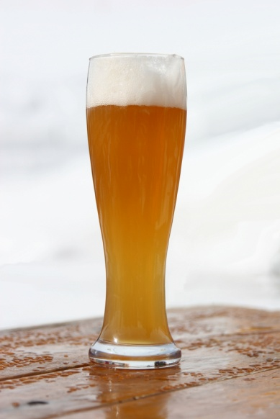
Purpose of bar operation
It is essential that any bar operation is able to prepare and serve beverages:
In a desired state
Consistently
In a timely manner
To maximise profits
Notes:
Class Activity – Questions
What is involved in achieving this purpose?
If you were a bar manager what would be the objectives you would have?

Slide 7
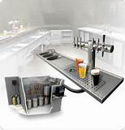
The cellar area
Cellar area
This is the main area designed to store alcohol that is to be served in a bar operation.
What equipment and items are found in a cellar?
Notes:
Class Activity – Question and Visit of cellar
Answer the question in the slide
Trainer to arrange visit of cellar.

Slide 8
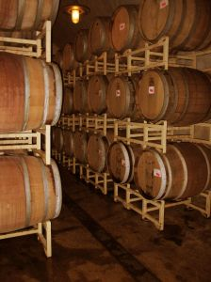
The cellar area
Items found in cellar area
Wine casks, bottles and bulk boxes
Beer kegs, bottles, cans and cartons
Spirit bottles and bulk containers
Soft drink bottles, cans and bulk boxes
Juices
Milk
Snacks
Notes:
Class Activity – Visit of cellar
Trainer to arrange visit of cellar
Discuss the purpose of these items as part of cellar visit.

Slide 9
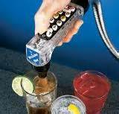
Bulk dispensing systems
Importance of bulk dispensing systems
One of the main components of a cellar operation is the use of bulk dispensing systems
In order to be able to serve large volumes of beverages in an appropriate time, most establishments will use bulk dispensing systems
Notes:
Class Activity – Questions
What is served using bulk dispensing systems?
What equipment is used in bulk dispensing systems?

Slide 10

Bulk dispensing systems
Benefits of bulk dispensing systems
Provides accurate and consistent drink portion sizes
Improves speed of beverage dispensing
Increases volume of sales
Improves efficiency for staff
Reduces waiting time for customers
Provides a clear record of drinks poured by station, shift and staff member
Notes:
Class Activity – Discuss benefits and disadvantages
Discuss the benefits of bulk dispensing systems
What disadvantages are there of these systems?

Slide 11
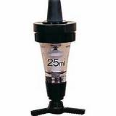
Bulk dispensing systems
Types of bulk dispensing systems
These may include:
Beer
Spirits
Wine
Post-mix syrups
Notes:
Class Activity – Discussion
Discuss the different types of systems.

Slide 12
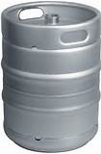
Beer dispensing systems
Beer system
Keg beer is the most common bulk beer dispensing system
Keg beer is a term for beer which is served from a pressurised keg
Notes:
Class Activity – Discussion
What is the benefit of using kegs?
How is beer distributed from kegs to the customer?

Slide 13

Spirit dispensing systems
Spirits system
Electronic dispensing units (EDU) are becoming popular as it not only makes the pouring of spirits more consistent and accurate, but an easier process.
Bottle dispensing units
Bulk dispensing units
Notes:
Class Activity – Discussion
What is the benefit of these spirit systems?
What is the difference between bottle and bulk dispensing units?
What is the common measurement dispensed by these units?

Slide 14
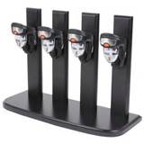
Spirit dispensing systems
Benefits of dispensing units
There are many benefits of using electronic spirit dispensing systems including:
Simple bottle loading and replacement
Reduced wastage of spirits
Easy assembly of minimal parts for quick washing and maintenance
Factory-set displacement valve and clear viewing bowl ensure accurate measures every time
Notes:
Class Activity – Discuss benefits and disadvantages of spirit dispensing equipment
Discuss the benefits of spirit dispensing systems
What disadvantages are there of these systems?

Slide 15
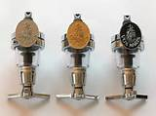
Spirit dispensing systems
Benefits of dispensing units
Dispensing indicator lights guarantee a fool-proof system
Digital counters record every shot dispensed for accurate assessment checks
Low impact, single-touch button makes pouring simple
Reliable power supply unit with lockable keys for maximum security
Notes:
Class Activity – Discuss benefits and disadvantages of spirit dispensing equipment
Discuss the benefits of spirit dispensing systems
What disadvantages are there of these systems?

Slide 16
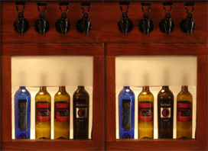
Wine dispensing systems
Increased trend of bulk wine dispensing systems
Bulk wine dispensing systems have become a great revenue earner for many beverage establishments.
What equipment is used in these systems?
How are they beneficial?
How do they differ from bottled wine?
Notes:
Class Activity – Discuss benefits and disadvantages of bulk wine dispensing equipment & Research activity
Discuss the benefits of bulk wine dispensing systems
What disadvantages are there of these systems?
Trainer to get audience to research different types of wine dispensing systems and associated costs.

Slide 17
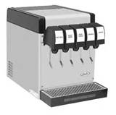
Soda dispensing systems
Post-mix system
A post mix system is the collective of equipment used to serve high volumes of carbonated beverages.
What equipment is associated with these systems?
What beverages are served using a post-mix system?
What is the difference between ‘pre-mix’ and ‘post-mix’ systems?
Notes:
Class Activity – Discuss benefits and disadvantages of post mix systems
Discuss the benefits of post mix systems
What disadvantages are there of these systems?

Slide 18
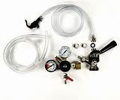
Cellar equipment
Other components of a cellar
Cool room
Transfer leads
Couplers
Connectors
Gas regulators
Chemicals, cleaning equipment and procedures
Safety goggles and gloves
Approved cleaning keg or dosing unit
Appropriate stock
Notes:
Class Activity – Discussion and demonstration
Discuss what these pieces of equipment are used for
Trainer to demonstrate these items and their uses.

Slide 19
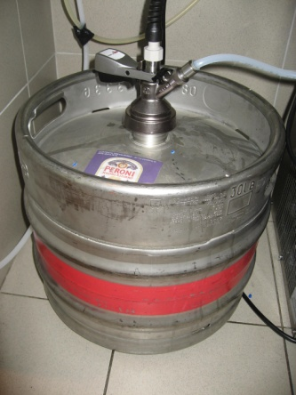
Role of cellar attendant
Bulk Beverage system
Cleaning and maintaining the draft beer system and keeping records up to date of equipment servicing
Monitoring the quality, temperature and service of beer in bars
Ability to find and correct faults in the draft beer system
Notes:
Class Activity – Discuss role of Cellar Attendant
Discuss the duties of a cellar attendant.

Slide 20
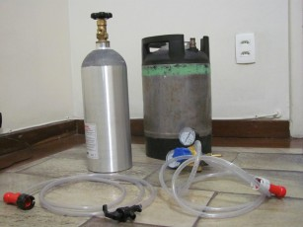
Role of cellar attendant
Bulk Beverage system
Monitoring bulk post mix, wine and spirit systems
Observing current Standards for occupational health and safety including the safe use of gas and chemicals and the hygienic handling of alcohol
Notes:
Class Activity – Discuss role of Cellar Attendant
Discuss the duties of a cellar attendant.

Slide 21
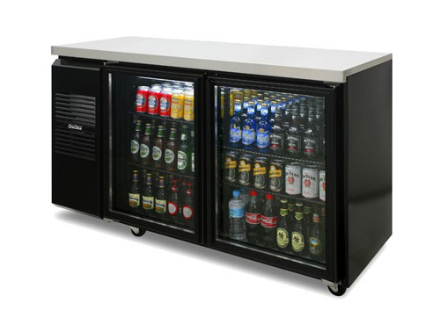
Role of cellar attendant
Stock control
Knowledge of all liquor groups and correct storage procedures for stock
Ordering stock from suppliers
Supplying stock to bars
Receiving, checking and storing deliveries, checking invoices and delivery notes and dealing with any discrepancies
Notes:
Class Activity – Discuss role of Cellar Attendant
Discuss the duties of a cellar attendant.

Slide 22
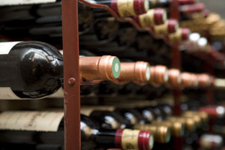
Role of cellar attendant
Stock control
Maintaining the cellar records of all stock coming in and going out
Conducting regular stock takes
Keeping all cellar and storage areas locked and controlling access to the keys
Rotating and storing stock correctly to avoid deterioration or spoilage
Notes:
Class Activity – Discuss role of Cellar Attendant
Discuss the duties of a cellar attendant.

Slide 23
Cellar attendant safety
Safety guidelines for the Cellar Attendant:
Wear safety boots
Wear Personal Protective Equipment when handling chemicals
Beware of CO₂ gas leaks
Beware of light fittings in wet conditions
Do not lift full kegs, use a trolley, or for short distances, roll keg along on bottom rim. Lift using your legs not your back
Notes:
Class Activity – Discuss importance of cellar attendant safety
Discuss the importance of these safety guidelines.

Slide 24
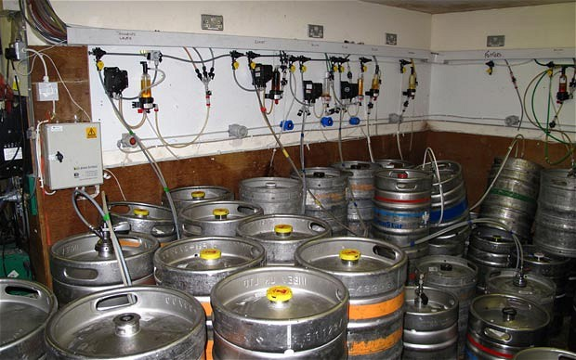
Cellar attendant safety
Safety guidelines for the Cellar Attendant:
Keep the cellar clean, neat and tidy at all times
Keep cellar equipment in good repair and take faulty equipment out of service
Report unsafe equipment or conditions to management
Employ a service technician to repair equipment
Notes:
Class Activity – Discuss importance of cellar attendant safety
Discuss the importance of these safety guidelines.

Slide 25
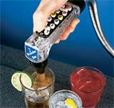
Operating dispensing systems
How to operate dispensing systems
How do you operate and maintain:
Spirit dispensing systems
Wine dispensing systems
Post mix dispensing systems
Notes:
Class Activity – Discussion
This section will explore how to use these systems but is a good introductory discussion to identify current understanding.

Slide 26
Spirit dispensing systems
Operating spirit dispensing systems
How do you use the following:
Spirit bottle dispensing units
Bulk spirit dispensing units
Spirit guns
Notes:
Class Activity – Demonstration
Trainer to demonstrate how to use these systems.

Slide 27

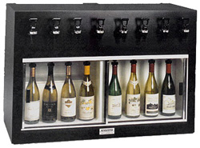
Wine dispensing systems
Operating wine dispensing systems
How do you use the following:
Spirit wine bottle dispensing units
Bulk wine dispensing units
Notes:
Class Activity – Demonstration
Trainer to demonstrate how to use these systems.

Slide 28
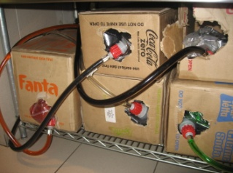
Post-mix dispensing systems
Main components of a post mix dispensing system
The main components include:
Water
CO₂
Carbonator
Syrup
Dispenser
Notes:
Class Activity – Discussion
What is the purpose of each of these components?

Slide 29
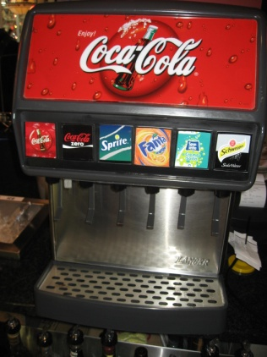
Post-mix dispensing systems
Types of systems
There are three main systems. These include:
Countertop electric refrigeration
Ice cooled system
Remote Refrigeration Cooling
Notes:
Class Activity – Discussion of systems
Trainer to discuss the differences of these systems.

Slide 30
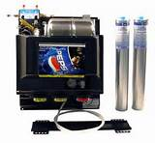
Post-mix dispensing systems
Using post mix systems
How do you:
Use a post mix system?
Handle, store and change CO₂ cylinders?
Handle and replace box syrup?
Notes:
Class Activity – Demonstration
Trainer to demonstrate how to use post mix systems.

Slide 31
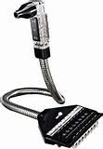
Post-mix dispensing systems
Cleaning post mix systems
How do you:
Clean a post mix system on a daily, weekly and monthly basis?
Clean soda dispensing lines?
Sanitise soda machines?
Clean soda dispensing gun?
Notes:
Class Activity – Demonstration / Discussion
Trainer to demonstrate/discuss how to clean post mix systems.

Slide 32
Identifying and resolving faults with dispensing systems
Common actions to rectify faults
There are a number of common actions that can be used, regardless of system or machine.
Appropriate action to rectify faults may include:
Gas system checking, identification and adjustment
Refrigeration system checking, identification and adjustment
Housekeeping, cleaning and maintenance
Stock control, rotation of stock
Notes:
Class Activity – Discussion
What are common faults of each dispensing system mentioned?
What are possible remedies?

Slide 33
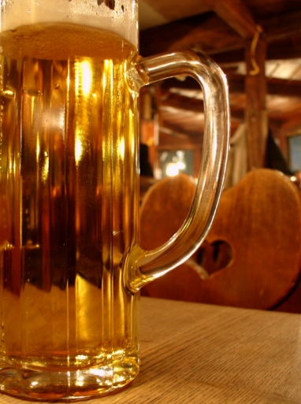
Element 2:
Operate and maintain beer reticulation systems
Notes:
Introduce topic.
Class Activity – General Discussion
Ask general questions:
Why are beer systems popular?
What are the benefits of these systems?
What equipment is associated with these systems?

Slide 34
Operate and maintain beer reticulation systems
Performance Criteria for this Element are:
Operate and clean beer reticulation systems in accordance with manufacturer’s instructions
Follow safety procedures regarding handling, connecting and storing of gas
Notes:
Trainer identifies the Performance Criteria for this Element, as listed on the slide.

Slide 35
Components of beer dispensing system
Main components of a beer dispensing system
Three main components of a beer dispensing system are:
Gas
Beer
Cooling
Notes:
Class Activity – Discussion
What is the purpose of each of these components?

Slide 36
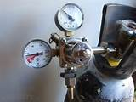
Components of beer dispensing system
Gas
Draft systems use CO₂ alone or mixed with nitrogen
Maintains the correct carbonation in the beer
Helps to preserve its flavour
Propels beer from the keg to the faucet
Notes:
Class Activity – Discussion / Demonstration
How do you handle, store, use and change gas cylinders?
Trainer to demonstrate where appropriate.

Slide 37
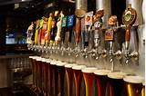
Components of beer dispensing system
Beer
The main component of beer systems
How is beer supplied?
What types of beer use dispensing systems?
How do you get beer to the customer using systems?
Notes:
Class Activity – Discussion / Demonstration
How do you handle, store, use and change gas cylinders?
Trainer to demonstrate where appropriate.

Slide 38
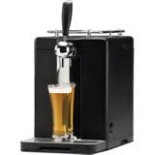
Components of beer dispensing system
Cooling
The cooling system should hold beer at a constant temperature from keg to glass.
Types of cooling systems:
Direct-draw system
Long-draw systems
Notes:
Class Activity – Discussion
What is the difference between these types of cooling systems?

Slide 39
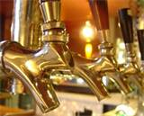
Beer systems equipment
Beer systems equipment
Beer dispensing systems normally comprise nine key components:
Refrigeration/Cooling
Keg
Coupler
Beer Line
Faucet
Gas Source
Regulator
Gas Line
Tailpieces and Connectors
Notes:
Class Activity – Discussion
What is the purpose of each piece of equipment?

Slide 40
Beer systems equipment
Refrigeration/Cooling
Consistent and controlled beer dispense requires that the beer travelling from keg to glass be maintained at a temperature of 1.1° to 3.3°C
Kegs
Kegs enable beer transport and dispense while maintaining its quality and integrity
Notes:
Class Activity – Discussion / Demonstration
Trainer to discuss and demonstrate each piece of equipment.

Slide 41
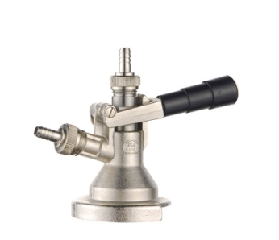
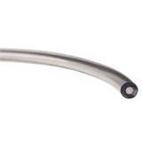
Beer systems equipment
Coupler
Gas flows in and beer flows out of a keg through the coupler
Line
Between coupler and faucet, beer travels through beer line selected to fit the needs of the specific draft application
Notes:
Class Activity – Discussion / Demonstration
Trainer to discuss and demonstrate each piece of equipment.

Slide 42
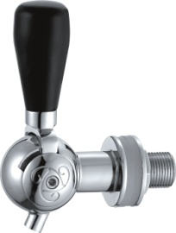
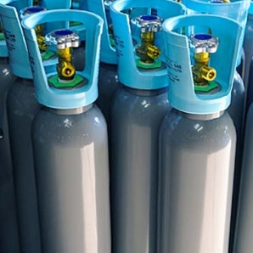
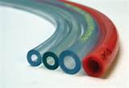
Beer systems equipment
Faucet
Faucets dispense beer to the glass
Gas Source
Beer systems depend on gas pressure to push beer from the keg to the faucet
Gas Line
Gas line should be selected to withstand the pressures expected in the draft system
Notes:
Class Activity – Discussion / Demonstration
Trainer to discuss and demonstrate each piece of equipment.

Slide 43
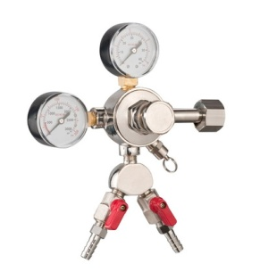
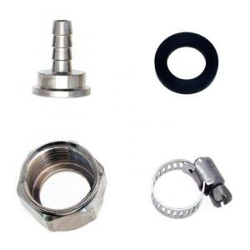
Beer systems equipment
Regulator
A regulator adjusts and controls the flow of gas from any source
Tail Pieces and Connectors
Tail pieces connect couplers, wall bracket, shanks or any other piece of equipment to vinyl tubing or other types of beer line
Notes:
Class Activity – Discussion / Demonstration
Trainer to discuss and demonstrate each piece of equipment.

Slide 44
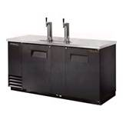
Handling kegs
Importance of handling kegs
The correct handling of kegs plays an important role in the ability to serve quality beer.
This includes the need to:
Chill kegs
Link kegs in a series
Notes:
Class Activity – Discussion
What is the importance of these handling activities?

Slide 45
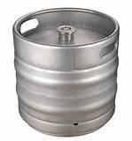
Handling kegs
Cold Storage and Proper Chilling of Kegs before Serving
Warm kegs cause more problems at the tap than nearly any other issue
Beer should remain at or slightly below 3.3°C
Notes:
Class Activity – Discussion
How do you keep kegs at the optimum temperature?

Slide 46
Handling kegs
Linking Kegs in Series
Busy establishments may connect kegs in a series or in a chain to meet peak capacity demands
Chaining two or three kegs of the same product together allows all of the chained kegs to be emptied before beer stops flowing
Notes:
Class Activity – Discussion
What is the benefit of linking kegs into a series?

Slide 47
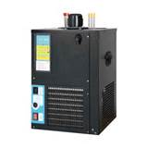
Connecting beer
Steps to connecting beer
The first steps when connecting the draft beer are to:
Turn on temprites
Drawing beer through to taps
Test for quality
Notes:
Class Activity – Discussion / Demonstration
Show how to connect beer.

Slide 48
Pouring beer
Pouring draft beer
Proper serving of draft beer is intended to have a “controlled” release of carbonation to give a better tasting and sensory experience
The evolution of CO₂ gas during pouring builds the foam head and releases desirable flavours and aromas
Notes:
Class Activity – Discussion
How should you pour beer?

Slide 49
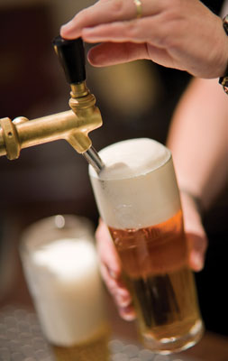
Pouring beer
Technique
Hold glass at 45º angle, open faucet fully
Gradually tilt glass upright once beer has reached about the halfway point in the glass
Pour beer straight down into the glass, working the glass to form a one inch collar of foam (“head”). This is for visual appeal as well as carbonation release
Close faucet quickly to avoid wasteful overflow
Notes:
Class Activity – Demonstration
Show how to pour beer.

Slide 50
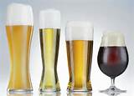
Handling glassware
Importance of ‘clean’ glassware
Properly designed and appropriately operated, your draft system pours perfect draft beer from its faucets
But the consumer’s experience can still be ruined by improper pouring, glass residue and unsanitary practices
Notes:
Class Activity – Discussion / Demonstration
How do you clean glasses?
How should glasses be stored?
What temperatures should glasses be for service?

Slide 51
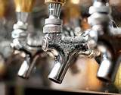
Beer system maintenance and cleaning
Cleaning Frequency and Tasks
Every two weeks (14 days)
Draft lines should be cleaned
All faucets should be completely disassembled and cleaned
All keg couplers or tapping devices should be scrubbed clean
Notes:
Class Activity – Discussion
Discuss the purpose of these cleaning activities.

Slide 52
Beer system maintenance and cleaning
Cleaning Frequency and Tasks
Quarterly (every three months)
Draft lines should be de-stoned
All FOB-stop devices should be completely disassembled and hand cleaned
All couplers should be completely disassembled and detailed
Notes:
Class Activity – Discussion
Discuss the purpose of these cleaning activities.

Slide 53
Beer system maintenance and cleaning
Cleaning Frequency and Tasks
Quarterly (every three months)
Draft lines should be de-stoned
All FOB-stop devices should be completely disassembled and hand cleaned
All couplers should be completely disassembled and detailed
Notes:
Class Activity – Discussion
Discuss the purpose of these cleaning activities.

Slide 54
Beer system maintenance and cleaning
Cleaning beer lines
It is important to clean your machines and system after every batch of beer you use
If you don't, you can ruin future batches of beer
Foamy beer can be caused by the build up of bacteria, yeast or mold within a beer line
Dirty beer lines can affect the quality and taste of beer, so it is important to regularly clean beer lines
Notes:
Class Activity – Discussion
How do you clean beer lines?

Slide 55
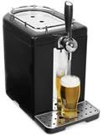
Identifying and rectifying problems with beer dispensing system
Types of common faults and remedies
Slow dispense at tap
Ensure dispense tap is working properly
Ensure sparkler is not too tight or blocked
Ensure lines are clean
Ensure gas cylinder is not empty
Notes:
Class Activity – Discussion
Discuss these steps.

Slide 56
Identifying and rectifying problems with beer dispensing system
Types of common faults and remedies
No dispense at tap
Ensure dispense tap is working properly
Ensure sparkler is not too tight or blocked
Ensure keg is not empty
Ensure line primer filled with beer
Ensure ball is floating
Ensure coupling head is fitted correctly
Change the keg
Notes:
Class Activity – Discussion
Discuss these steps.

Slide 57

Identifying and rectifying problems with beer dispensing system
Common checks
Check the keg first if you notice a problem with the beer as you pour it
Notice the flow of the beer when you pull on the tap handle
Check the gauge on your CO₂ tank
Notice the level of foam pouring out of the tap
Taste the beer for correct temperature
Have your draft beer lines cleaned
Have your keg cooler checked for correct temperature
Notes:
Class Activity – Discussion
Discuss these checks.

Slide 58
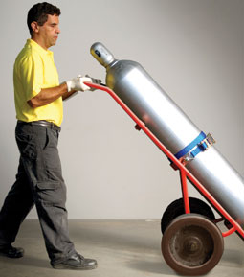
Handling, connecting and storing gas
Importance of handling gas correctly
Gas is a common and essential component of bulk dispensing systems
It is essential that when handling gas it is done so in a manner that is safe for the operator
Notes:
Class Activity – Discussion
How do you handle, connect and store gas correctly?

Slide 59
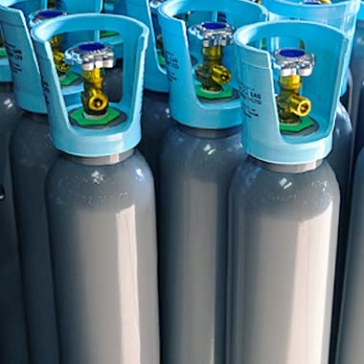
Handling, connecting and storing gas
Knowledge of beverage gas system operations
Any cellar operator must have an understanding and working knowledge of not only the key components of beverage dispensing systems, as identified to date, but also of beverage gas system operations.
What should a cellar operator know when it comes to ‘gas knowledge’?
Notes:
Class Activity – Discussion
Discuss the question in the slide.

Slide 60
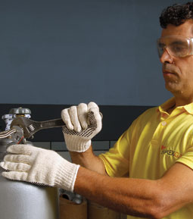
Handling, connecting and storing gas
Knowledge of beverage gas system operations
How to handle, store, connect and disconnect beverage gas cylinders
Inert gas in confined spaces and the potential dangers
Particular dangers of carbon dioxide and nitrogen
Required fire protection equipment and other emergency and alarm procedures
Methods and techniques for undertaking routine checks for leaks
Notes:
Class Activity – Discussion
How can a cellar operator build their knowledge?

Slide 61
Handling, connecting and storing gas
Gas safety guidelines
Assess your cellar to identify safety hazards
Prevent build up of CO₂
Never tamper with cylinders
Store cylinders correctly
Handle cylinders correctly
Do not overstock gas supplies
Notes:
Class Activity – Discussion
Who should perform these tasks?
Why are they important?

Slide 62
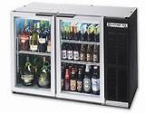
Element 3:
Use and maintain refrigeration systems
Notes:
Introduce topic.
Class Activity – General Discussion
Ask general questions:
What types of refrigeration systems are used in a commercial bar?

Slide 63
Use and maintain refrigeration systems
Performance Criteria for this Element are:
Measure refrigerator temperatures accurately and adjust correctly to comply with product requirements
Clean and maintain refrigerator components
Set or re-set walk-in alarms to manufacturer's specifications
Recognise and repair/report basic mechanical faults in accordance with enterprise procedures
Notes:
Trainer identifies the Performance Criteria for this Element, as listed on the slide.

Slide 64

Refrigeration systems
Types of refrigeration systems
Glycol system or refrigerated beer line system
Glycol tanks and pumps
Compressors
Chiller plates
Cold rooms
Notes:
Class Activity – Discussion
What is the difference between these systems?

Slide 65

Refrigeration systems
Types of refrigeration systems
Cabinets
Instantaneous coolers
Portable coolers
Ice bank or water chilled system
Temprite or instantaneous cooler system
Notes:
Class Activity – Discussion
What is the difference between these systems?

Slide 66

Refrigeration systems
Commercial bar refrigerators
Kegerators
Back Bar Refrigerators
Shallow & Deep Well Bottle Coolers
Glass Frosters / Chillers
Merchandise / Display fridges
Walk in Coolers
Notes:
Class Activity – Discussion
What is the difference between these systems?

Slide 67

Refrigeration system temperature
Methods to check refrigeration temperatures
There are two ways to check the temperature inside a refrigerator:
One way checks the air temperature inside the refrigerator
Another way gives the internal temperature of something in the refrigerator
Notes:
Class Activity – Discussion
What is used to test these temperatures?
What is the ideal temperature for refrigerators?

Slide 68

Refrigeration system temperature
Types of commercial refrigerator thermostats
Commercial refrigerator thermostats measure and regulate the temperature in large commercial refrigerators
They do this by opening and closing an electric current that turns the refrigerator's compressor on and off
Notes:
Class Activity – Research activity
Trainer to get audience to research different types of thermostats and related equipment that can be used in commercial bar operations.

Slide 69

Refrigeration system temperature
Types of commercial refrigerator thermostats
Air Sensing
Evaporator Coil Sensing
Pressure Sensing
Notes:
Class Activity – Research activity
Trainer to explain difference between these methods to identify fridge temperature.

Slide 70

Refrigeration system components
Refrigerator components
Refrigerator components may need to be cleaned on a regular basis include:
Vents
Coils
Filters
Seals
Catches
Notes:
Class Activity – Discussion
What is the purpose of these components?
How do you clean and maintain them?

Slide 71

Refrigeration system systems
Importance of monitoring and control systems
Given the substantial value often associated with bar stock it is not surprising some establishments will have refrigeration monitoring and control systems installed.
What types of systems are used?
What do they ‘monitor’ and ‘control’?
Notes:
Class Activity – Discussion
Discuss questions in the slide.

Slide 72

Refrigeration system systems
Purpose of system products
These systems are designed to:
Protect perishables
Save energy
Increase operator safety
Notes:
Class Activity – Discussion
What other benefits exist?
How much money can they systems actually save?

Slide 73

Refrigeration system systems
Types of system products
Products within these systems include:
Single and multipoint temperature alarms
Web enabled data logging systems
Door monitor and alarms
Panic (entrapment) alarms
Notes:
Class Activity – Discussion
Types of system products
Products within these systems include:
Single and multipoint temperature alarms – this is important as it is vital that temperatures of food and beverage items remain within acceptable temperature ranges
Web enabled data logging systems – records who enters fridges and at what time
Door monitor and alarms – notifies when fridge doors are opened
Panic (entrapment) alarms – commonly found in ‘walk-in’ fridges that notifies the appropriate person when someone has been locked into a unit.

Slide 74

Identify refrigeration system faults
Compressor
The compressor increases or decreases the temperature and pressure of any air vapor entering the refrigeration unit
Common faults:
Items are not remaining cold
No ‘motor running sound’
Notes:
Class Activity – Discussion
How do you fix these faults?

Slide 75

Identify refrigeration system faults
Fluctuating Temperature
Possible checks include:
Operation temperatures
Subheat and subcooling
Temperature controls are turned down to a cold setting
If temperature controls have failed
Notes:
Class Activity – Discussion
Discuss how to perform these checks.

Slide 76

Identify refrigeration system faults
Fans
Fans help regulate the temperature of components inside the refrigerator
Possible checks include making sure:
Fans of the fridge are working
Fans are clean and free of debris
Wiring going to the fans is in good working order
No visible wire damage
Fans are receiving power
Notes:
Class Activity – Discussion
Discuss how to perform these checks.

Slide 77

Identify refrigeration system faults
Reporting basic mechanical faults
When mechanical faults have been recognized it is essential that they are reported immediately to the most appropriate person.
Why is it important that faults are reported immediately?
Who is the appropriate person?
What is the best way to communicate faults?
What information should be given?
What should you do with equipment that appears to be faulty?
Notes:
Class Activity – Discussion
Discuss questions in the slide.

Slide 78

Element 4:
Monitor quality of cellar products
Notes:
Introduce topic.
Class Activity – General Discussion
Ask general questions:
Why is it important to monitor quality of products?
Which products should be test?

Slide 79
Monitor quality of cellar products
Performance Criteria for this Element are:
Test regularly quality of cellar products and identify faults
Make adjustments within scope of individual responsibility or report faults to the appropriate person or people
Use bin and keg card systems to assist in monitoring the quality of products and controlling stock
Keep cellar tidy, clean and free from litter
Monitor cellar temperature
Notes:
Trainer identifies the Performance Criteria for this Element, as listed on the slide.

Slide 80

Test quality of cellar products
Types of cellar products
Beers
Spirits
Wine
Post-mix syrups
Notes:
Class Activity – Discussion
How can you test these products?

Slide 81

Test quality of cellar products
Beer – faults and remedies
Cloudy beer
No head on beer
Beer fobbing in glass
What are remedies for each of these faults?
Notes:
Class Activity – Discussion
Cloudy beer
Cleaning pipes every week
Ensure key is still within ‘best before date’
Flush through lines with water
Connect to a new keg.
No head on beer
Ensure staff are trained in pouring
Ensure tap sparkler is in place
Ensure beer tap is being used correctly
Ensure correct glass cleaning techniques are used.
Beer fobbing in glass
Ensure beer is poured at correct angle
Ensure beer is at correct temperature.

Slide 82

Test quality of cellar products
Spirits – faults and remedies
Strength of spirit
Strange taste
Beverage taste soapy
What are remedies for each of these faults?
Notes:
Class Activity – Discussion
Strength of spirit
At times the amount of spirit being dispensed may be more or less than what is required. Check the equipment.
Strange taste
The dispenser may have been used for another bottle of alcohol. It must be cleaned correctly.
Beverage taste soapy
It is important to ensure that it is cleaned properly.

Slide 83

Test quality of cellar products
Wine – faults and remedies
Cloudy or scaly wine
Wine smell or taste bad
Wine is going off quickly
What are remedies for each of these faults?
Notes:
Class Activity – Discussion
Cloudy or scaly wine
Cloudy or scaly wine is always a symptom of a dirty system and poor maintenance. Incorrect machine use may also contribute to this condition.
Wine smell or taste bad
New units may cause some wines to have a slightly different taste or smell. This is normal and will diminish very rapidly. It should disappear completely within 1-3 days.
Wine is going off quickly
Wines are expected to last approximately one to three weeks. Therefore it if the problem occurs before this time it will vary based on a number of factors being temperature, wine age and wine type, and cleanliness of the machine.

Slide 84

Test quality of cellar products
Post mix – faults and remedies
Product is flat
Product is warm
Product is flavourless
Wrong product is being dispensed
What are remedies for each of these faults?
Notes:
Class Activity – Discussion
Product is flat
Check CO2 levels to ensure carbonation is taking place.
Product is warm
Check refrigeration system.
Product is flavourless
Ensure they syrup box contains syrup
Ensure syrup is going through lines
Ensure line connections are sealed
Ensure line is connected to syrup box.
Wrong product is being dispensed
Ensure lines are connected to correct syrup box.

Slide 85

Test quality of cellar products
Importance of glassware
Quite often many problems relating to the appearance and taste of finished products are directly related to the condition and cleaning procedures towards glassware and not the equipment itself.
How can you ensure glasses are ‘clean’?
Notes:
Class Activity – Discussion
How do you ensure glasses are clean?

Slide 86
Bin and keg key systems
Importance of bin and keg key systems
Like in any high volume bar establishment, the enormous volumes of alcohol and the value attached to them is a considerable and important asset that must be monitored and controlled to ensure that the beverage items are correctly:
Identified
Stored
Used before expiry dates
Notes:
Class Activity – Discussion
How are these systems used?

Slide 87

Bin and keg key systems
Aims of bin and keg key systems
The overriding aims of bin or keg key systems are to:
Easily identify when an item or collective of items were purchased
To track their usage in an establishment
Notes:
Class Activity – Discussion
How can this be achieved?

Slide 88
Bin and keg key systems
Benefits of bin and keg key systems
Easier identification of similar bottles, especially those from different vintages
Easier to track volume of items
Tracks actual consumption
Ensures greater control of inventory
Ensures appropriate stock location
Notes:
Class Activity – Discussion
Discuss these benefits.

Slide 89

Bin and keg key systems
Benefits of bin and keg key systems
Identify how long they have been in stock
Identify when they should be used
Helps facilitate stocktaking
Helps enable accurate accounting records which identifies actual cost of goods sold
Notes:
Class Activity – Discussion
Discuss these benefits.

Slide 90
Bin and keg key systems
Keg Key Systems
Keg key systems are used to identify and record beer kegs
Given that beer kegs have a limited shelf life, however look the same, there must be a way to identify individual kegs
Notes:
Class Activity – Discussion
How do keg key systems work?

Slide 91
Bin and keg key systems
Bin Card Systems
Bin cards are normally associated with individual beverage bottles in storage
The most common type of beverage which uses a bin system is wine
Given the endless makes, styles and vintages of wine, there needs to be a system which can easily identify bottles or batches of wine purchases
Notes:
Class Activity – Discussion
How do bin card systems work?

Slide 92

Bin and keg key systems
Bin Card Systems
Quite often a bin system incorporates inventory software and recording systems and the use of ‘identification’ tags placed around the necks of wine and other beverage bottles or on boxes of product
This ensures each bottle or box is traceable
The unique bin number/s on each bottle neck tag / box allows every bottle or box to be found with ease and removed with accuracy
Notes:
Class Activity – Discussion
Discuss the operations of these systems.

Slide 93

Bin and keg key systems
Benefits of wine tagging systems
Identify your wine locations
Place your wines randomly
Reduce the search area
Finding select wine
Maintaining an accurate inventory
Notes:
Class Activity – Discussion
Discuss these benefits.

Slide 94

Keep cellar tidy and clean
Importance of keeping cellar tidy and clean
As a cellar contains beverages, it essentially must follow the usual hygiene requirements that apply to any food and beverage establishment or outlet
It is essential that the cellar must fulfil modern health and safety regulations
Notes:
Class Activity – Discussion
What health regulations must be followed?
What safety regulations must be followed?
How do you maintain a clean and tidy cellar?

Slide 95
Keep cellar tidy and clean
Cleaning and maintaining cellar area
Only keep items that are essential
Remove used containers, boxes etc on a regular basis
Store items in a logical manner
Ensure a clear path to move and transport items
Cleaning on a regular basis, especially when spills occur
Keep cellar walls and floors clean
Notes:
Class Activity – Discussion
Discuss these steps.

Slide 96

Keep cellar tidy and clean
Cleaning and maintaining cellar area
Ensure walls are treated with an anti-fungal paint or cleaner
Ensuring suitable lighting
Cleaning drains and sumps on a regular basis
Ensuring there is hot and cold running water access for cleaning
Maintain good ventilation to remove stale air and build up of CO₂ gas
Keep cleaning containers clean
Notes:
Class Activity – Discussion
Discuss these steps.

Slide 97

Keep cellar tidy and clean
Cleaning and maintaining cellar area
Store cleaning chemicals and equipment in appropriate and secure location
Keep water hoses on their reels and secure
Ensure all gas cylinders are correctly stored
Use all retaining chains to limit movement of gas cylinders
Remove empty kegs, casks and bottles on a regular basis
Reseal casks when empty
Notes:
Class Activity – Discussion
Discuss these steps.

Slide 98
Monitor cellar temperature
The importance of temperature in all aspects of beverage storing and dispensing is critical in ensuring the finished product is dispensed in its optimal condition
Different temperatures have different reactions for different beverages
Notes:
Class Activity – Discussion
Why is cellar temperature important?

Slide 99

Monitor cellar temperature
Optimal cellar temperature
Cellar cooling equipment should give a cellar temperature of 10 to 12 degrees centigrade and run for a maximum of 16 hours out of every 24 hours.
How do you monitor cellar temperature accurately?
Notes:
Class Activity – Discussion
Discuss the question in the slide.

Slide 100
Monitor cellar temperature
Maintaining cellar cooling equipment
Ensure any cellar cooling equipment to be working correctly
Equipment must be regularly serviced by specialised technicians
Air vents on equipment must be kept clear
Notes:
Class Activity – Discussion
Discuss these points.

Slide 101
Monitor cellar temperature
Use and placement of thermometers
There should be two quality thermometers
Placed in different parts of the cellar
Located at different heights to ensure accurate measurements can be taken
Not be placed in direct flow of cooler air or up against walls
Notes:
Class Activity – Discussion
Discuss these points.

Slide 102

Monitor cellar temperature
Importance of cellar temperature for beer
Beer be stored and dispensed from a cool room set at 2 to 10 degrees Celsius.
Where cool rooms are not available, the following points should be adhered to:
Avoid temperatures above 20 degrees Celsius
Thorough cleaning of all equipment becomes extremely critical
It is important to note that keg beer needs approximately 72 hours to adjust to cellar temperatures
Notes:
Class Activity – Discussion
Discuss these points.

Slide 103
Monitor cellar temperature
Importance of cellar temperature for wine
The best temperature to store wine is between 12 to16 degrees Celsius
How can you ensure bottled wine is stored correctly?
What are considerations when storing wine?
How does temperature effect a bottle of wine?
Notes:
Class Activity – Discussion
Discuss the questions in the slide.

